Slide 1
IMAGE SENSORS

Slide 2
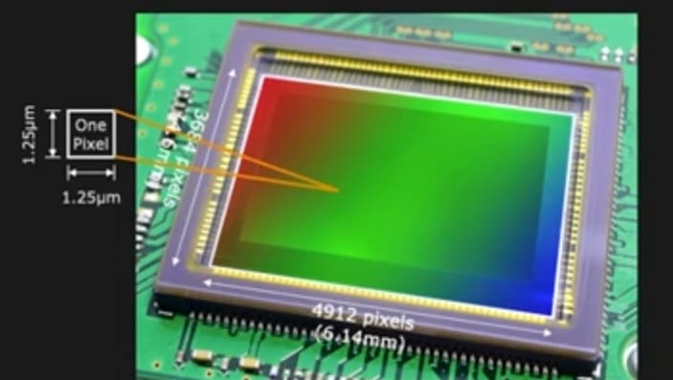
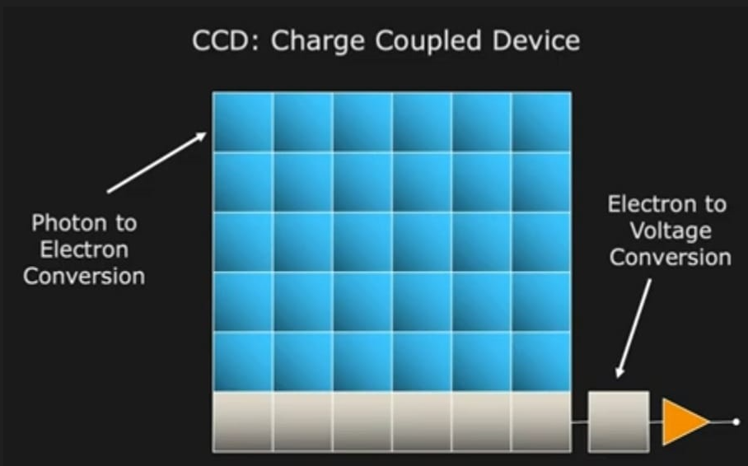
CCD IMAGE SENSOR

Slide 3
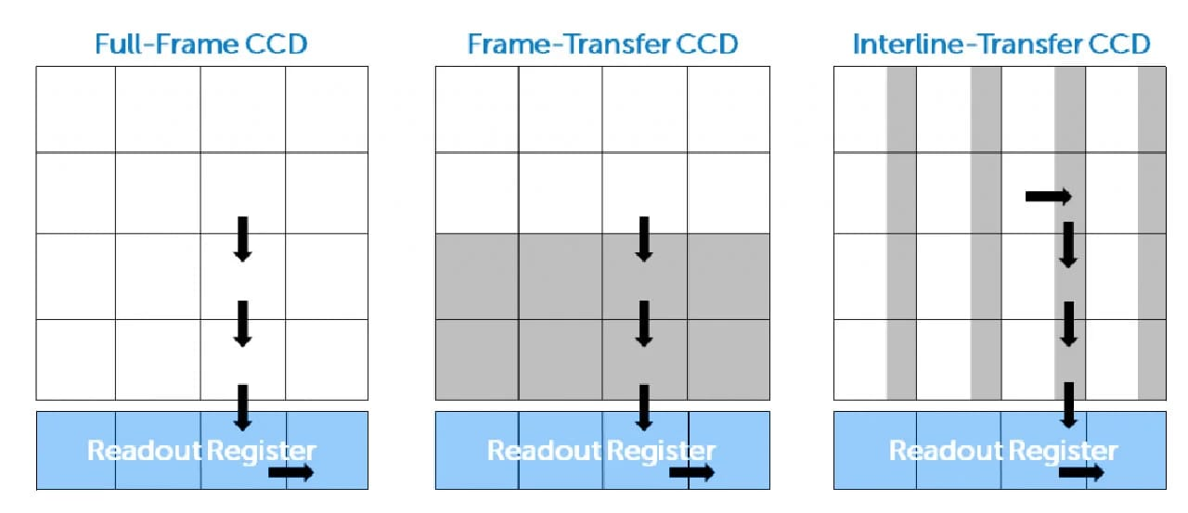
TYPES OF CCD SENSOR

Slide 4
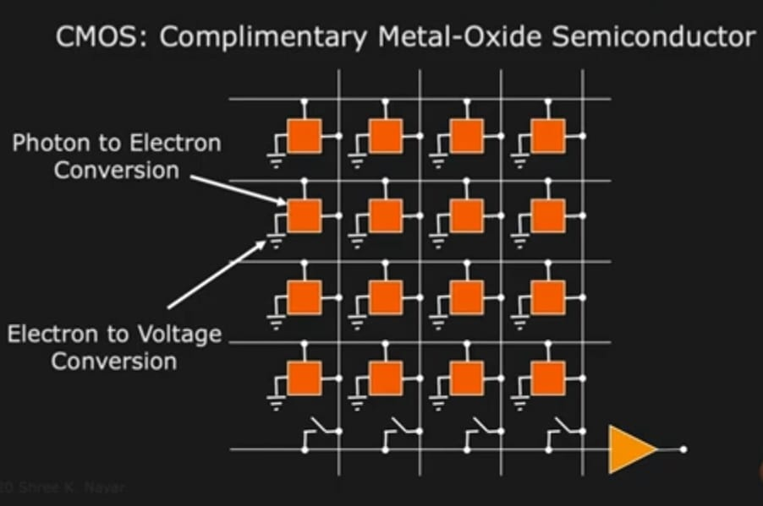
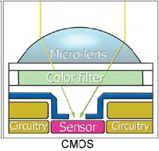
CMOS IMAGE SENSOR

Slide 5
ROLLING SHUTTER VS GLOBAL SHUTTER

Slide 6
CCD SENSOR
CMOS SENSOR
It is used to transmit electrically charged signals.
Low power consumption.
Low complexity.
Moderate to the high noise level.
More expensive.
It is use dto change light into an electrical signals.
Moderate to high power consumption.
Moderate complexity.
Low noise level.
Less expensive.

